Slide 1

Clampers
presented by: Fatima Abbas Laghari

Slide 2
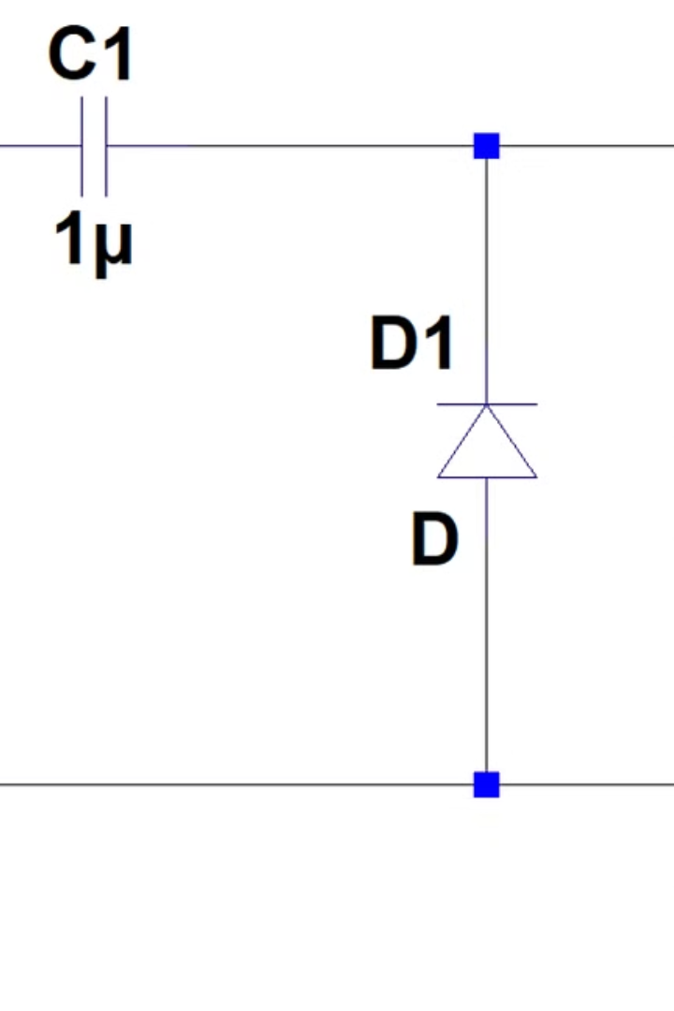
Introduction to Clampers
Clamper circuits, also known as DC restorer circuits, are electronic circuits used to shift the DC level or average voltage of a waveform without affecting its shape.

Slide 3
Types of Clampers
Positive Clampers
Negative Clampers
Positive clampers shift the signal to a positive reference level, ensuring the signal does not fall below a certain voltage.
Negative clampers shift the signal to a negative reference level, ensuring the signal does not rise above a certain voltage.

Slide 4
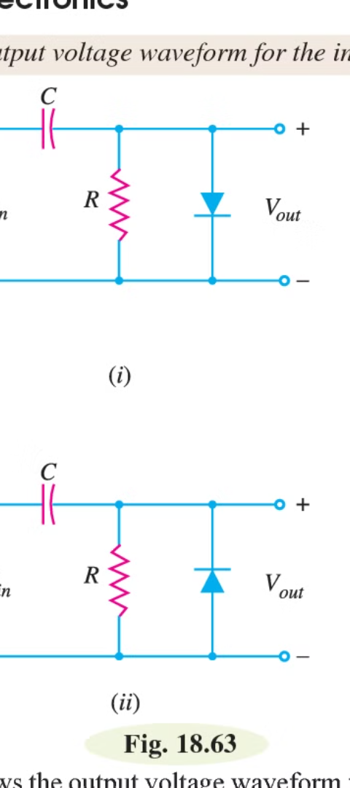
Negative Clampers
1
Fundamental Operation
2
Noise Reduction
Negative clampers use a diode and a capacitor to shift the signal's average value to a negative reference level.
Negative clampers can help remove unwanted positive noise components from the signal.
3
Voltage Limiting
Negative clampers ensure the signal does not exceed a certain negative voltage, protecting sensitive components.

Slide 5
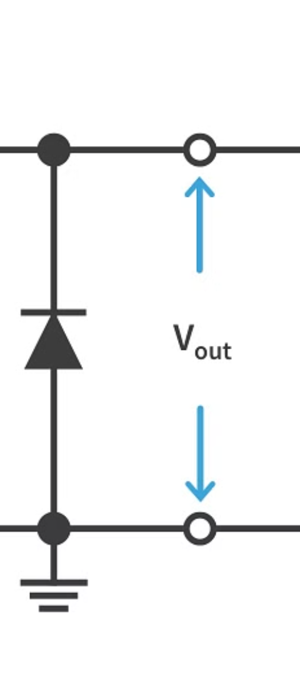



Positive Clampers
Input Signal
The input signal is a varying waveform with an unwanted DC offset.
Clamping Action
The positive clamper circuit shifts the signal's average value to a positive reference level.
Stabilized Output
The output signal is now centered around the desired positive reference level.

Slide 6
Applications of Clampers
Audio amplification:
Signal display:
Process of converting weak electrical signals into stronger signals. Clampers increase the power of the signal without changing its original sound.
Clamper circuits help ensure that the signal you see on a display device, like an oscilloscope, is properly centered and scaled for easy viewing and analysis.
Data Transmission:
In data transmission, clamper circuits make sure the signal being sent is just right. They adjust the signal's strength to keep it within the right range so that the data can be received correctly on the other end.

Slide 7
THANK YOU!

